Slide 1
CLTV Advertisers
Sandeep David Golkonda

Slide 2

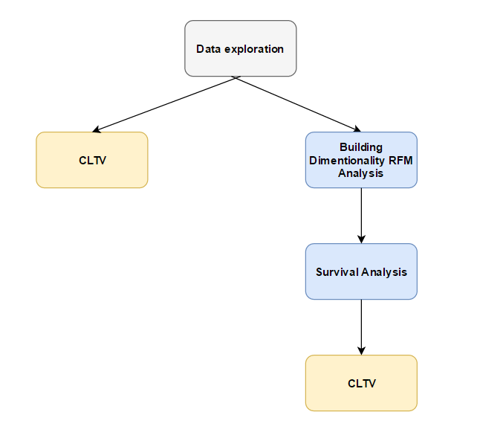
Summary
80% of the revenue is generated by only 0.1% of the customers. Remaining customers account to 5 million.
Developed data dimension using Recency Frequency and Monetary value.

Slide 3
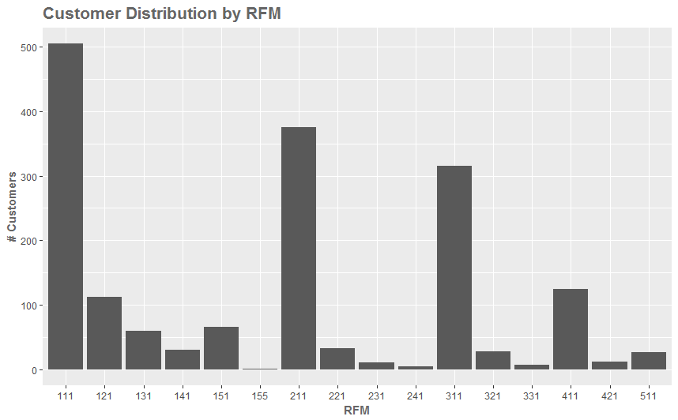
Assumptions
11% of customers with low RFM score are classified as churned who contribute 1.2% to revenue.
Removing the highly contributing variables did not have an impact on the RFM score.
Discount rate 9% for next year
11%

Slide 4
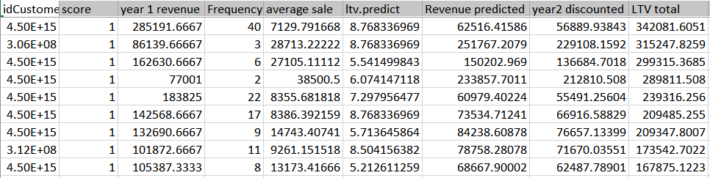
Conclusion
Total Customer life time value without using RFM & Survival 47,492,800
Total Customer life time value using survival model 35,846,643

